Slide 1

EDA
HOTEL BOOKING ANALYSIS
Presented By:
Jenny & Hareshree
Guided By:
Abhishek Wavhal

Slide 2
TABLE OF CONTENTS
Project Summary
01
Problem Statement
05
Analysing Data
Data Cleaning
02
06
Expected Outcomes
Data Visualization and Analysis
03
07
About Data
Conclusion
04
08

Slide 3

01
PROJECT SUMMARY

Slide 4
PROJECT OVERVIEW
To evaluate City Hotel and Resort Hotel's business performance from 2015 to 2017, we conduct an in-depth study of them. This analysis covers various subjects: operational effectiveness, customer satisfaction, market positioning, financial performance, occupancy and revenue management, sales and marketing tactics, and strategic planning. Our goal is to provide meaningful insights to improve operations, increase profitability, and foster sustainable growth for both hotels by analyzing market dynamics and key performance metrics.

Slide 5
02
ANALYSING DATA

Slide 6
DATA PREPARATION
Cleaning: Fill Missing Values and Remove Duplicates. Explanation of data cleaning procedures, including filling missing values to ensure completeness and removing duplicates to ensure data integrity.
Importance of these steps in preparing high-quality data for analysis.

Slide 7
VISUALIZATION and REPORTING OVERVIEW
Introduction to the importance of visualization and reporting in conveying insights effectively to stakeholders.

Slide 8
COMPARATIVE ANALYSIS
Explore our comparative analysis of City Hotel and Resort Hotel.
Uncover insights from separate evaluations and combined assessments.
Discover key strengths, weaknesses, and strategic opportunities for both establishments.

Slide 9
03
EXPECTED OUTCOMES

Slide 10

EXPECTED OUTCOMES
Improved Decision-Making:
Decreased Cancellations:
The project aims to assist hotels in making more informed choices to enhance guest experiences.
It will identify the reasons behind guest cancellations and work towards minimizing them.

Slide 11

EXPECTED OUTCOMES
Enhanced Profit Margins:
By analyzing guest booking patterns, hotels can strategically price their services to boost profitability.
Stay Competitive:
By understanding guest preferences, hotels can tailor their advertising to attract more customers and stay competitive.

Slide 12
EXPECTED OUTCOMES
Strategic Positioning:
Long-Term Strategy:
Analyzing the project will give hotels insights into their position compared to competitors, enabling them to position themselves in the market strategically.
This initiative will assist hotels in developing a long-term strategy by identifying trends and opportunities for growth in the future.

Slide 13
04
ABOUT DATA

Slide 14
ABOUT DATA
Booking Information:
Hotel Type: Resort or City
Cancellation Status: Booked (0) or Cancelled (1)
Lead Time: Number of days between booking and arrival
Arrival Details: Year, Month, Week Number
Duration of Stay: Number of nights for weekends, number of nights for weekdays
Guest Details:
Guest Breakdown: Adults, Kids, Infants
Country of Residence: Guest's native land
Client Category: Specific four groups
Returning Guest: Yes (1) or No (0)
Meal Choice: Meal type reserved

Slide 15
ABOUT DATA
Booking History:
Previous Cancellations: Number of past cancellations
Number of confirmed bookings: Number of past non-cancelled bookings
Room Information:
Type of Room Reserved: Code for the room type that was reserved
Type of Room Assigned: Code for the room type that was assigned
Changes to Booking: Total number of modifications made to the reservation.

Slide 16
ABOUT DATA
Financials & Extras:
Average Daily Rate (ADR): Calculated price per day
Deposit Type: Type of deposit made
Required Extras: Number of car parking spaces, specific requests
Booking Channels:
Market Segment: Classification based on booking trends
Distribution Channel: Method of distributing bookings
Agent/Company ID: Unique identifier for booking agents or companies.

Slide 17
ABOUT DATA
Reservation Status:
Number of Days in Waiting List: Duration on the waiting list
Current Reservation Status: Present booking status
Last Update of Reservation Status: Date of the most recent status change

Slide 18
05
PROBLEM STATEMENT

Slide 19
PROBLEM STATEMENT
The dataset consists of booking information for a city hotel and a resort hotel, including the booking date, number of adults, children, and babies, available parking spaces, booking agent, and other relevant information. This project examines and analyzes the data to determine important factors affecting bookings.
What is your objective for the business?
We will analyze and visually represent the booking data for both the City Hotel and Resort Hotel to better understand the different factors that influence the bookings and the Average Daily Rate (ADR).

Slide 20
06
DATA CLEANING

Slide 21
DATA CLEANING
During the Exploratory Data Analysis, various pre-processing steps were implemented to ensure data cleanliness.
There were a total of 1,19,390 rows and 32 columns.
Removed errors from the data.
Removed 31,998 duplicate rows from the data.
Merged columns [Day], [Month] and [Year] into a column called [Arrival_Date] and converted data type to Date. After creating the column, we dropped [Day], [Month] and [Year] columns.
Merged columns [Stay_in_weekend_nights] and [Stay_in _week_nights] into a column called [Total_Number_Days].
Merged columns [adults], [children] and[babies] into a column called [Total_Guests].
Replaced NULL/missing values in the [Agent], [Country] and [Children] columns with Other.
Removed [Company] column as most in the column were NULL.
Remove the [Days_in_waiting_list] column, as most values were NULL.
Replaced Undefined values in the [Meals] column with Others.
Added a calculated column called [Week of Day], which stores the day of the week in words rather than numbers.
Added index column called Booking ID.

Slide 22
07
DATA VISUALIZATION & ANALYSIS

Slide 23
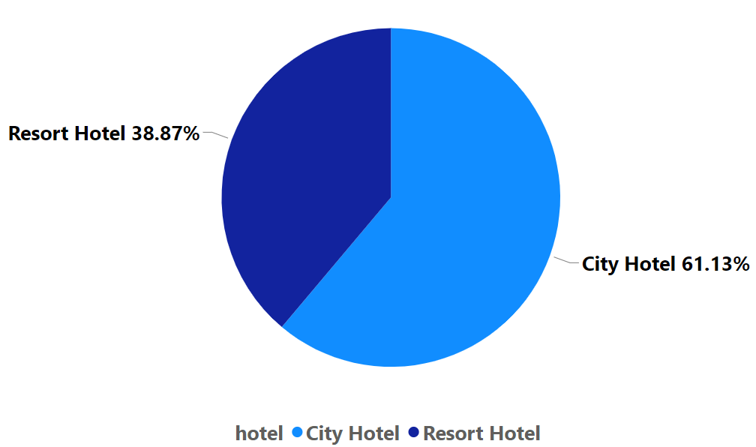
MOST PREFERRED HOTEL TO STAY
Based on the Pie chart, we can say that 61.13% of people prefer the City Hotel and 38.87% of people prefer the Resort Hotel.
Based on these observations, we understand that city hotel provides services which attract more guests.
Resort hotels can use these observations to find solutions to attract more guests by finding out the services provided by the city hotels.

Slide 24
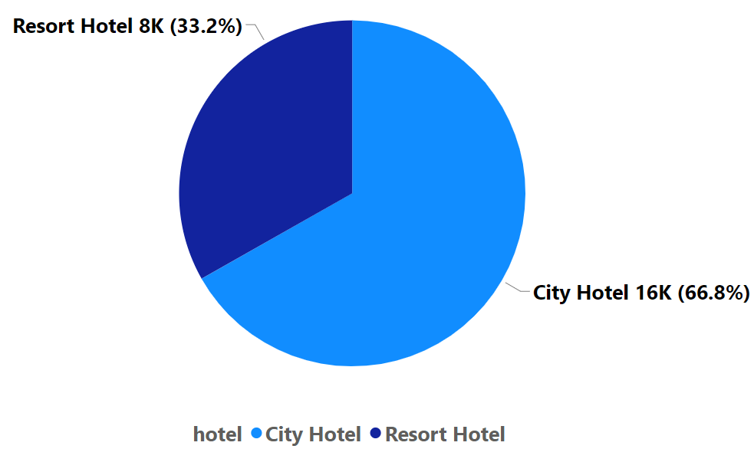
MOST CANCELATIONS BY HOTEL
Based on the Pie chart, we can say that City Hotel has faced 66.8% cancellations i.e. approx. 16K and Resort Hotel has faced 33.2% % cancellations i.e. approx. 8K.
Based on these observations, we say that though the city hotel has a higher number of bookings, it also has a higher number of cancellations.

Slide 25
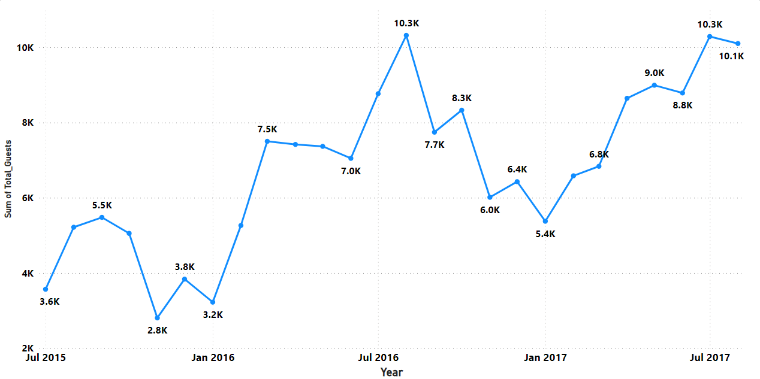
MONTH WITH THE MAXIMUM NUMBER OF GUESTS
The Line chart shows data between 2015-2017. Based on the line chart, we can say that most guests arrive during July and August i.e. approx. 10.3K, and the lowest numbers arrive in January, i.e. approx. 5.4K.
Based on these observations, we say that hotels can offer promotional events and offers to guests during the months with fewer guests to encourage more people to visit the hotels.

Slide 26
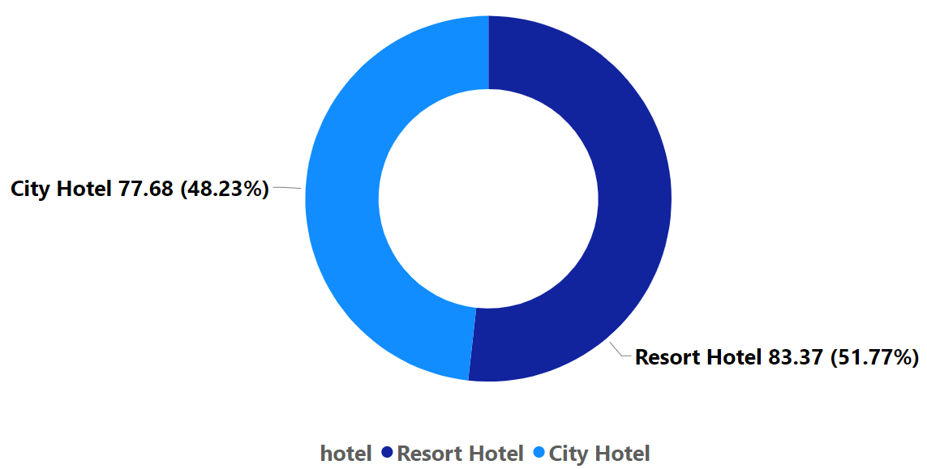
AVERAGE ADVANCED BOOKING BY HOTEL
Based on the Donut chart, we can say that City Hotel has 66.8% advanced booking, i.e. before 77.68 days, and Resort Hotel has 33.2% % advanced booking, i.e. before 83.37 days.
Based on these observations, we say that guests prefer to advance book Resort hotels as compared to city hotels.

Slide 27
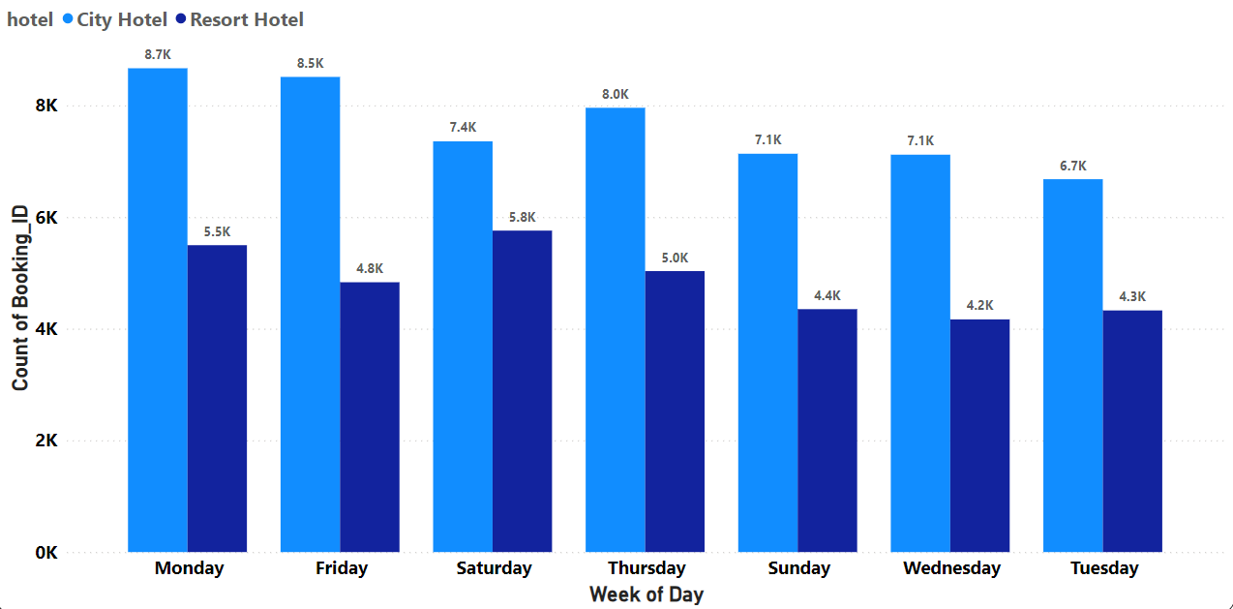
WEEKLY NUMBER OF GUESTS BY HOTELS
The Clustered Column chart shows weekly data by hotels. Based on the column chart, we can say that most guests arrive on Monday for City Hotels approx. 8.7K, while for Resort Hotels, more guests arrive on Saturday approx. 5.8K.

Slide 28
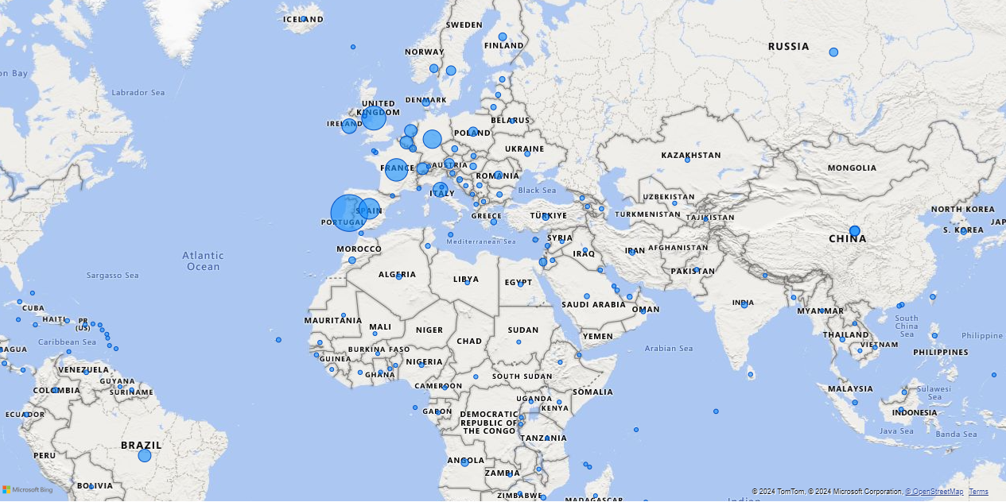
GUESTS FROM MOST VISITED COUNTRIES
The Map shows from which country the maximum number of guests visit.
Based on the map, we can say that most guests visit from Portugal, the UK and France, i.e., approx. 27.45K, 10K and 9K people respectively.

Slide 29
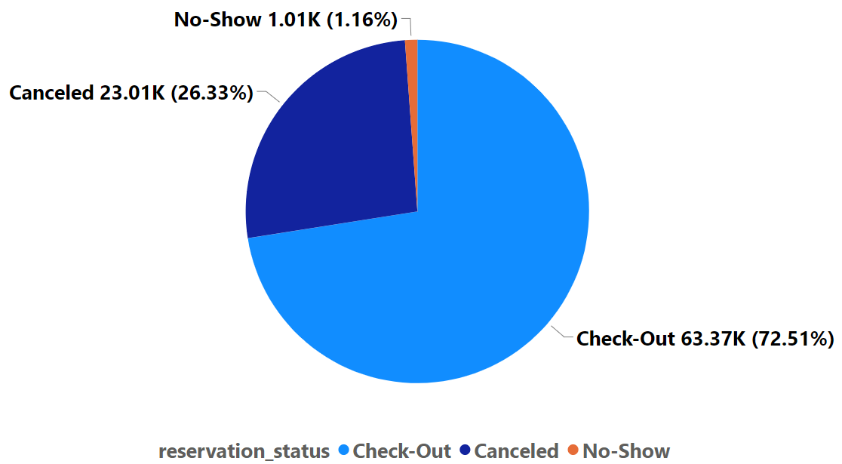
BOOKING STATUS OF GUESTS
Based on the Pie chart, we can say out of all the bookings, 72.51% of guests Checked-Out, 26.33% of guests Cancelled the booking, while only a small percentage, i.e. 1.16% of guests, were a No-Show.

Slide 30
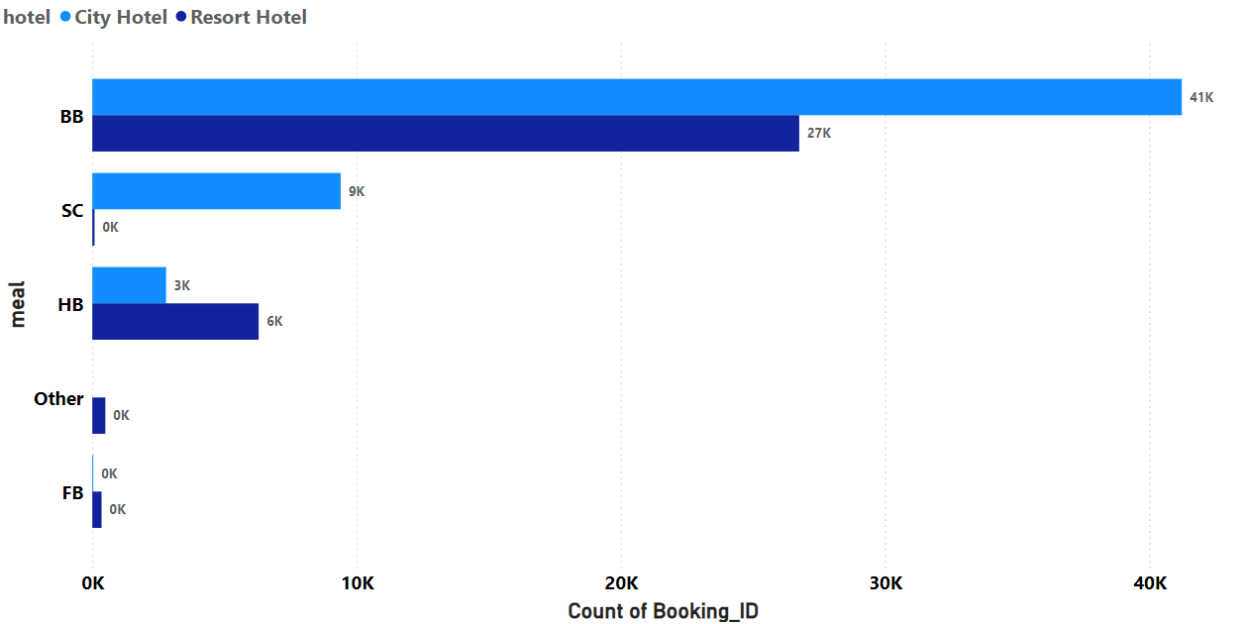
MOST PREFERRED MEAL TYPES OF HOTELS GUESTS
The Clustered Bar chart shows the most preferred meals for guests of different hotels.
Based on the bar chart, we can say that most guests prefer BB meal type, which is approx. 41K people for City Hotel and 27K for Resort Hotel.

Slide 31
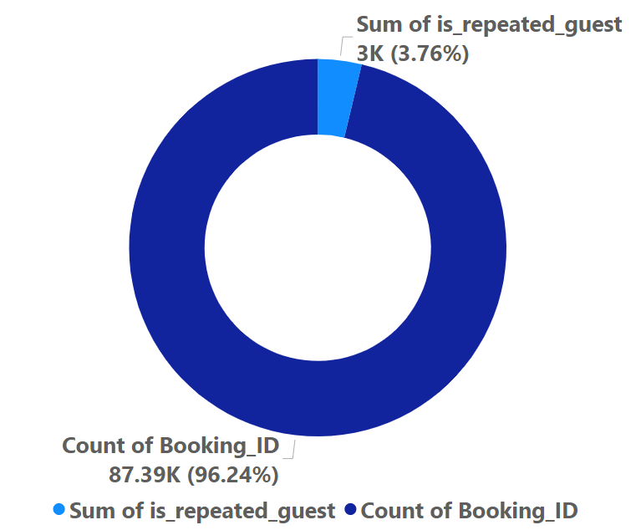
PROPORTION OF REPEATED GUESTS
Based on the Donut chart, only a tiny portion of guests are repeat visitors, about 3.76%.
Based on this observation, we can understand that hotels need to find solutions to encourage more guests to come back to the hotels.

Slide 32
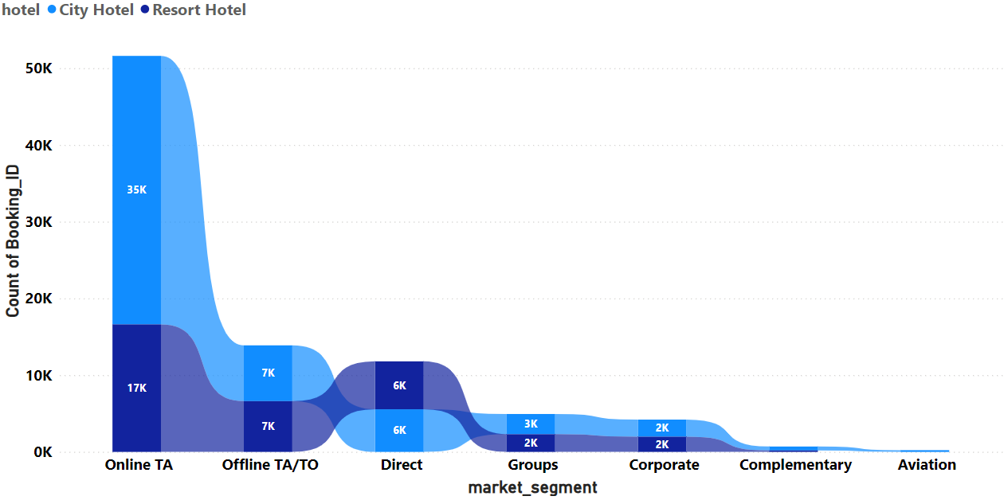
MOST PREFERRED MARKET SEGMENT
The Ribbon chart shows the most preferred market segment for different hotels.
Based on the ribbon chart, we can say that the most preferred market segment is Online TA, which is approx. 35K for the City Hotel and 17K for the Resort Hotel, respectively.

Slide 33

WEEKLY AND ANUAL INSIGHTS
DASHBOARD

Slide 34
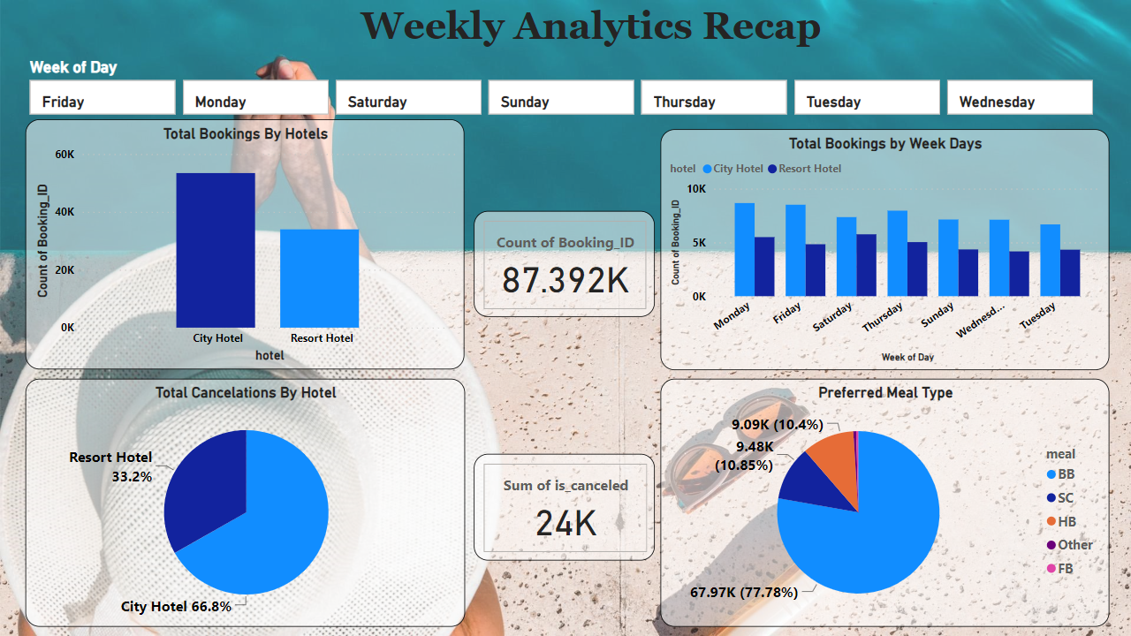

Slide 35
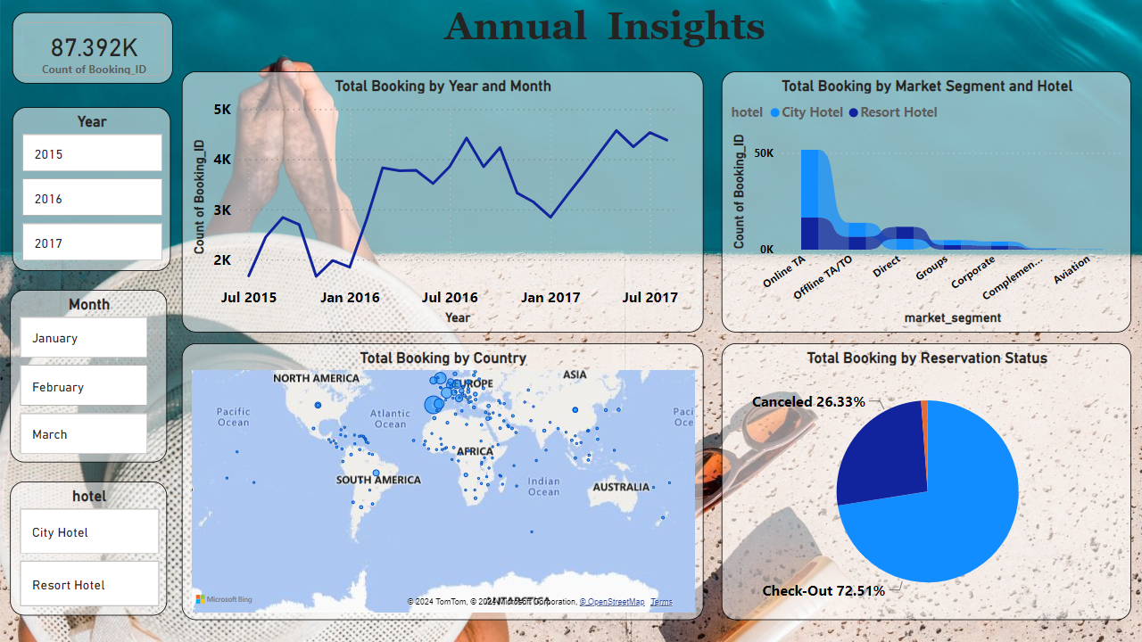

Slide 36
08
CONCLUSION

Slide 37
TO CONCLUDE
City Hotels has a higher overall booking rate than Resort Hotels. To improve this, Resort Hotels should consider the services provided by City Hotels to boost the number of bookings.
The City Hotel has a higher rate of cancellations than Resort Hotels. By implementing focused strategies to retain guests, the hotel could substantially decrease the impact on its revenue.
August is one of the peak months for bookings. Hotels should manage their resources during these months and conduct promotional activities during months with fewer bookings.
By promoting early-bird specials, hotels can encourage reservations well before the usual lead time of 75 to 85 days, enhancing financial liquidity and diminishing the rates of last-minute room availability.
Focusing on ‘BB’ as the preferred meal choice and customizing the dining options and experiences could improve guest contentment.
Concentrating marketing efforts specifically in Portugal, the UK, and France, where most guests come from, could increase reservation numbers.
The low rate of returning guests highlights the opportunity for implementing loyalty programs to increase the number of repeat stays.
A considerable volume of reservations is secured via agents, highlighting the need to cultivate robust partnerships with these intermediaries.

Slide 38
THANKS!

